Slide 1

Overcoming Impact: Deformable Drones for Dynamic Operations
Student Researcher - Nathaniel van der Leeuw
Mentor – Dr. Jekan Thangavelautham
Space and Terrestrial Robotic Exploration (SpaceTREx) Laboratory
Aerospace and Mechanical Engineering Department
University of Arizona

Slide 2
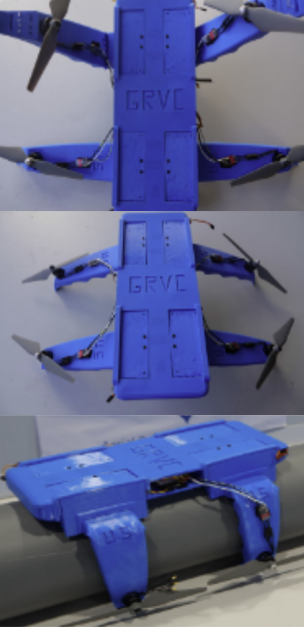
Flexible UAVs and Deformable Structures
Traditional drones have rigid components which cannot change properties inflight and can pose risks to operators
Biomimetic approaches seek to balance flight stability with the resiliency of soft materials
Deformable drones can withstand collisions with a complex environment ensuring safety and prolonging usage
[1]

Slide 3
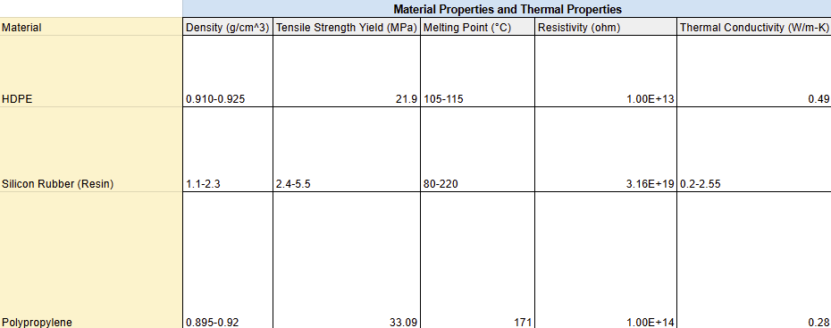
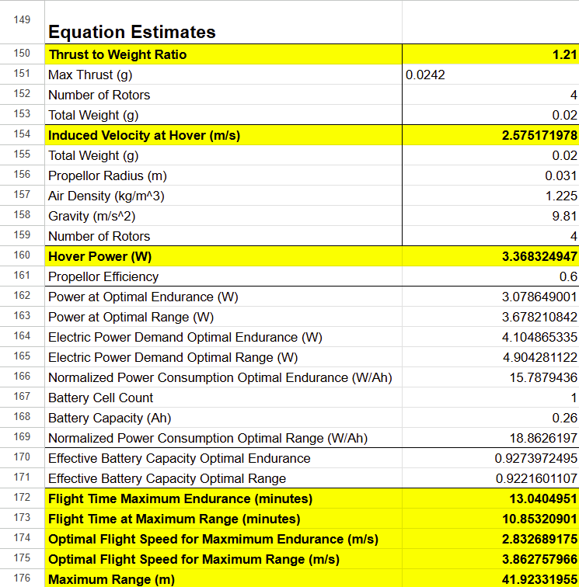
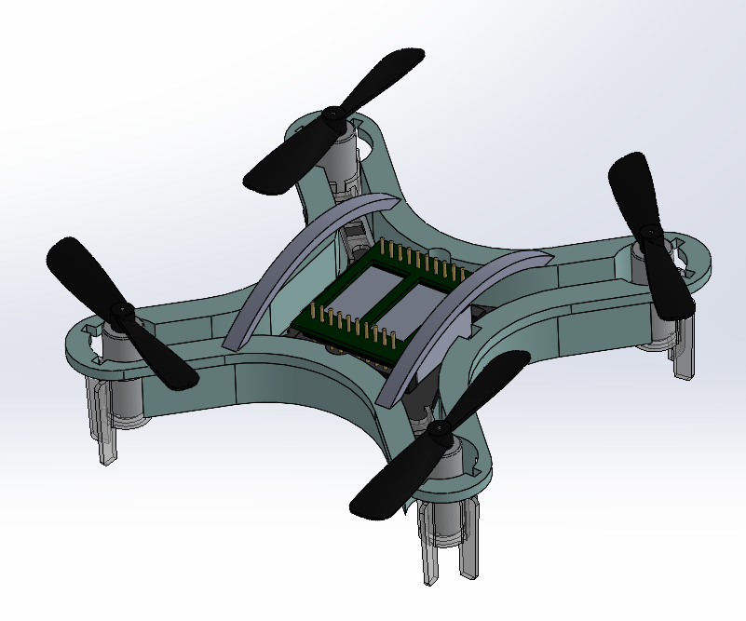
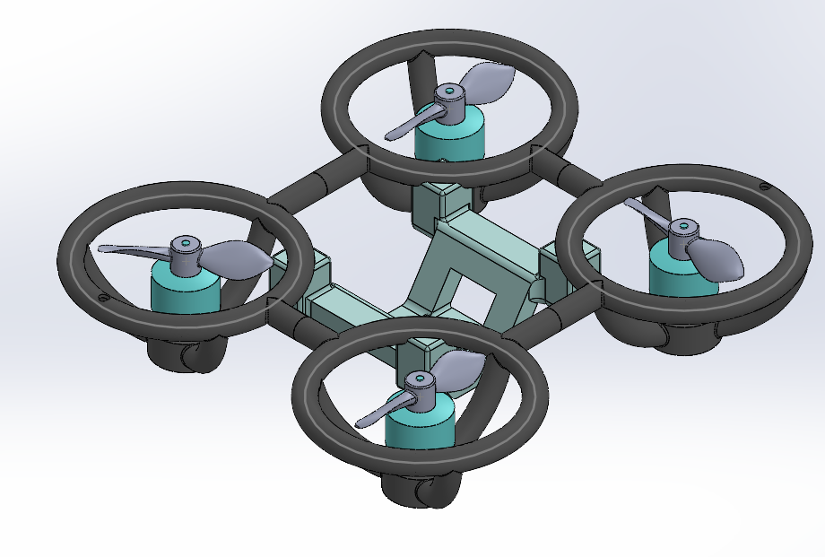
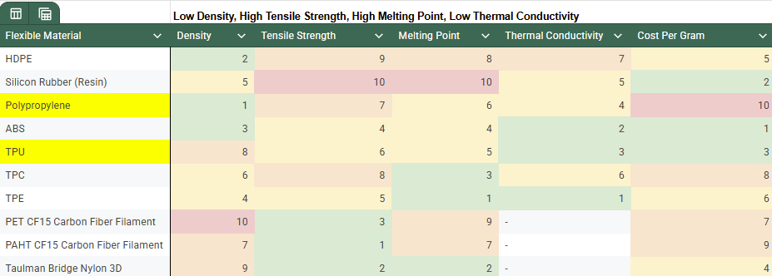
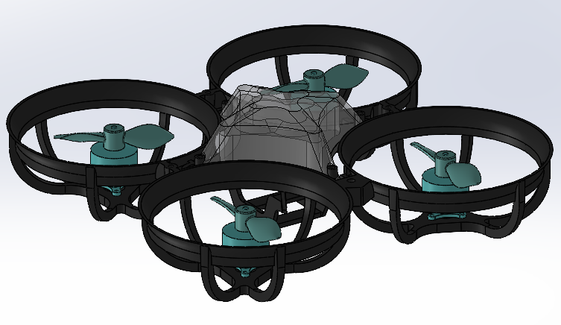
Material Selection and Design Process
Polymer Trade Studies
Component Estimates
Flexible Frames

Slide 4
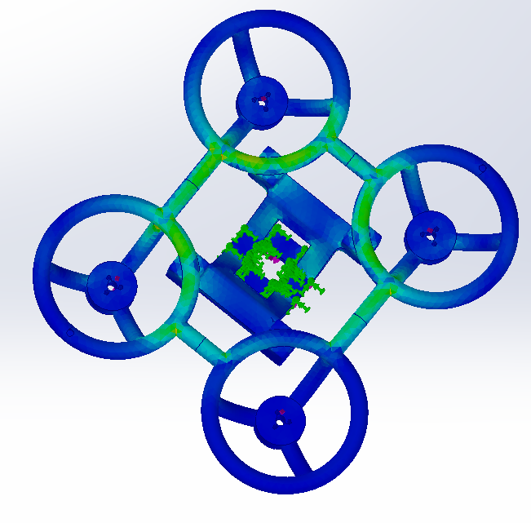
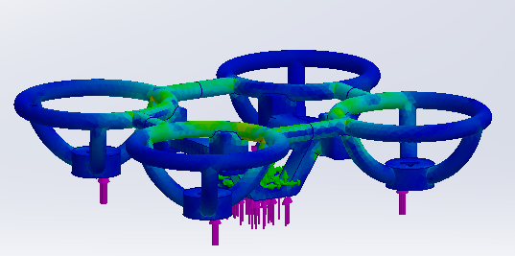


Finite Element Analysis (FEA)
Impact force experienced from a sudden crash at maximum range velocity and from dropping 3m were utilized in static load simulations
Von Mises Stress was used to see if the design would yield
Equivalent Strain (ESTRN) was used under the assumption of a linear maximum load
Von Mises Stress
ESTRN

Slide 5
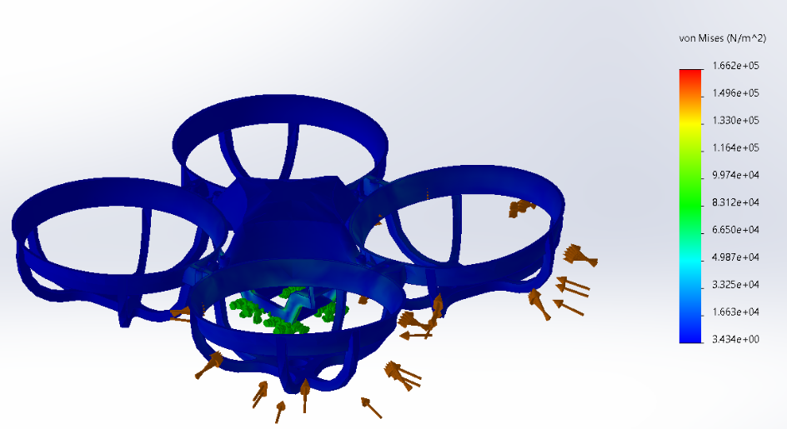
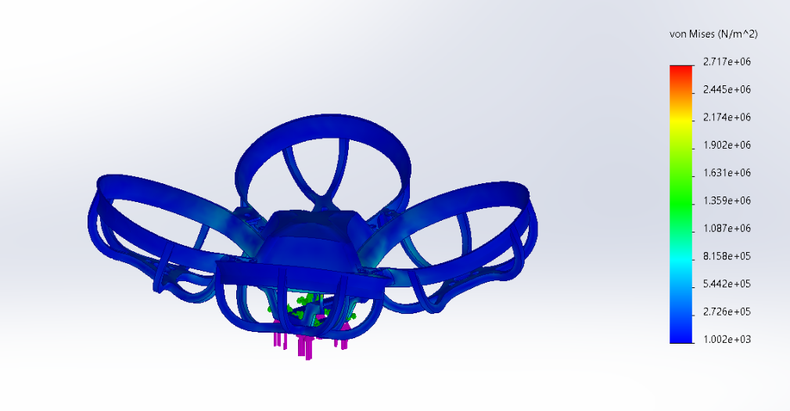
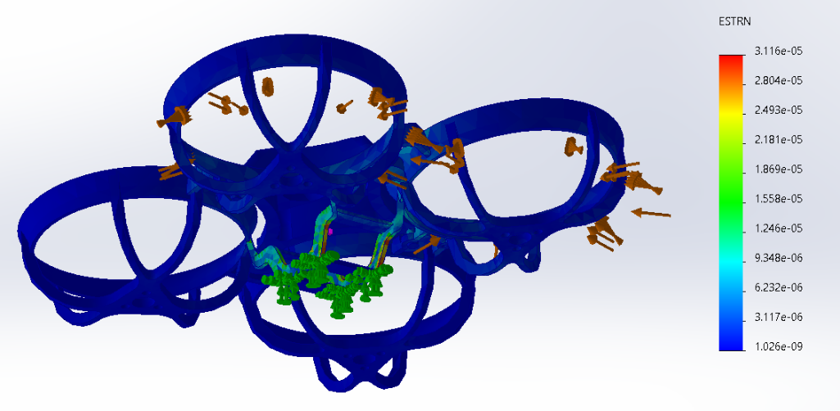
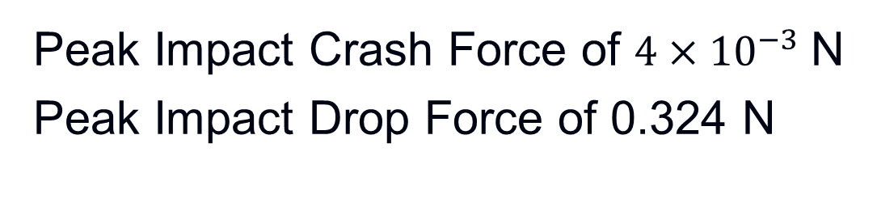
Impact Test Results – Generic FPV Design
Stress
(3m) Drop
Strain
Peak Impact Crash Force of $4×{10}^{−3}$N
Peak Impact Drop Force of 0.324 N

Slide 6
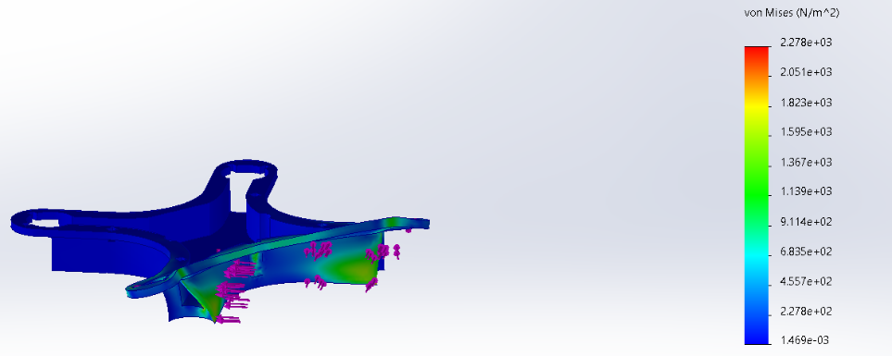
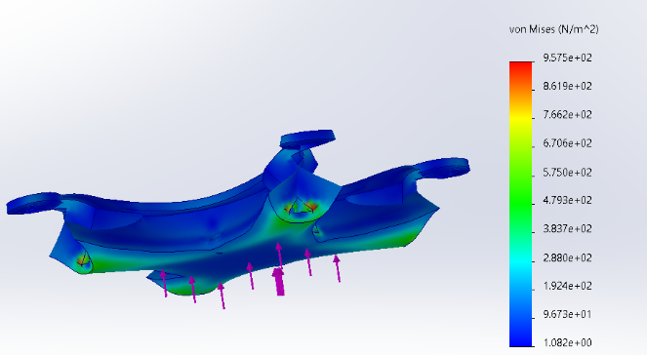
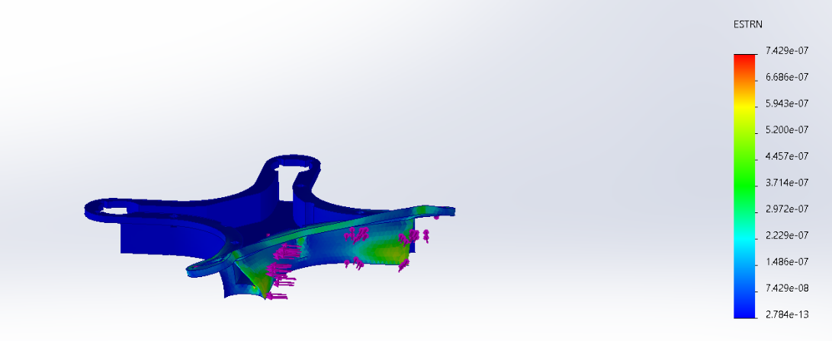
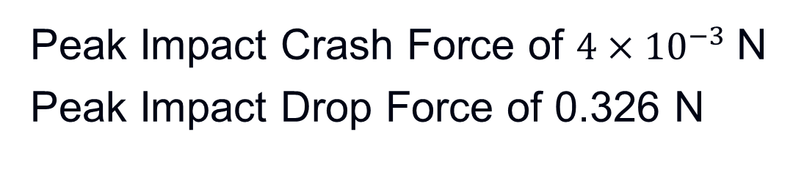
Impact Test Results – Solid Frame Design
Stress
(3m) Drop
Strain
Peak Impact Crash Force of $4×{10}^{−3}$N
Peak Impact Drop Force of 0.326 N

Slide 7
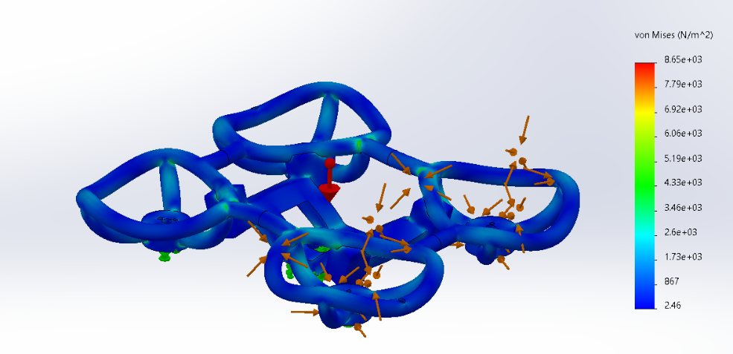
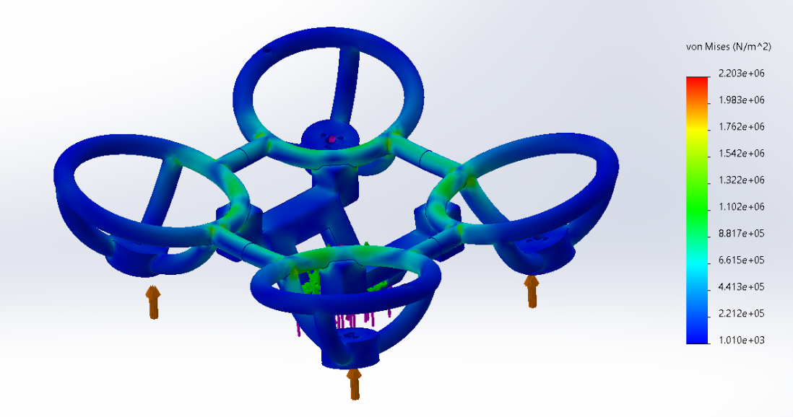
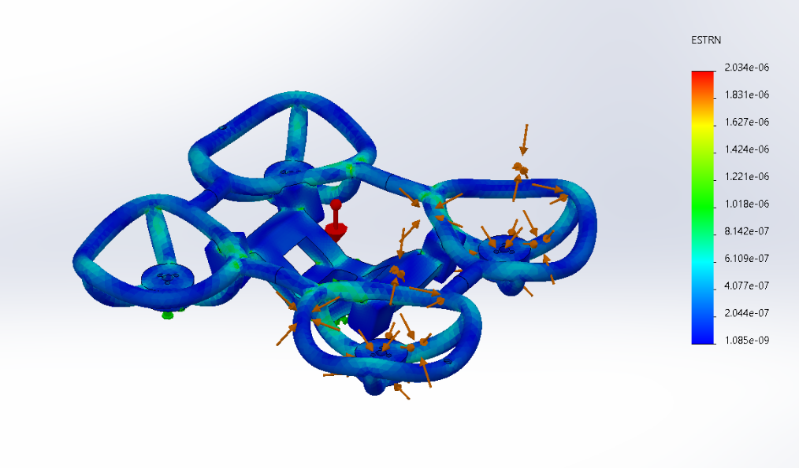
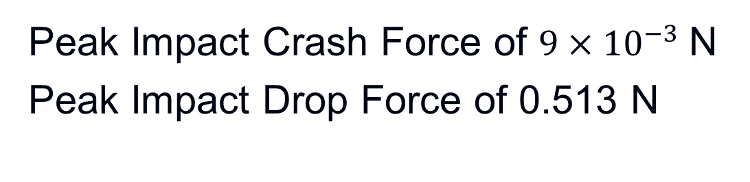
Impact Test Results – Hollow Frame Design
Stress
(3m) Drop
Strain
Peak Impact Crash Force of $9×{10}^{−3}$N
Peak Impact Drop Force of 0.513 N

Slide 8
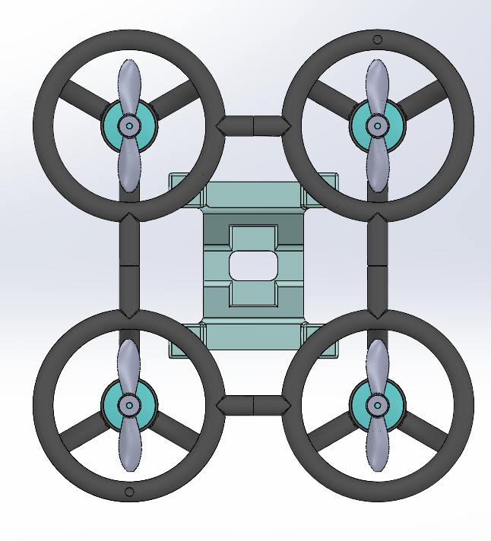
Conclusions and Future Work
The Hollow Frame is the optimal design since significant deformation can occur before failure
Structural Behavior can be modified by injecting different fluids into the internal cavity
Future fluid simulations and real-world impact testing are necessary to model take off behavior, acceleration, and deformation

Slide 9
Acknowledgments
Thank you Dr. Jekan Thangavelautham and SpaceTREx Laboratory

Slide 10
References
[1] F. Ruiz, B. C. Arrue and A. Ollero, "SOPHIE: Soft and Flexible Aerial Vehicle for Physical Interaction With the Environment," in IEEE Robotics and Automation Letters, vol. 7, no. 4, pp. 11086-11093, Oct. 2022, doi: 10.1109/LRA.2022.3196768. keywords: {Autonomous aerial vehicles;Arms;Aerodynamics;Inspection;Vehicle dynamics;Solid modeling;Rotors;Contact inspection;multirotor dynamics;soft aerial robotics;UAVs},

Slide 11
THANK YOU

